Slide 1
K-MEANS AND HIERARCHICAL CLUSTERING-MARKET SEGMENTATION OF AIRLINES
BY ATANU DAS

Slide 2
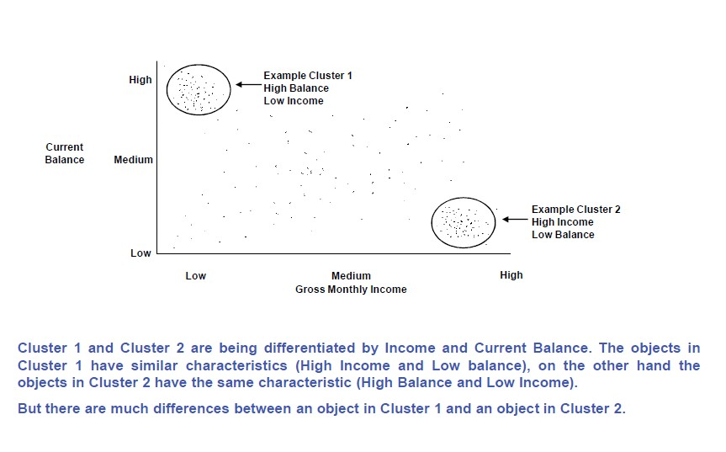
CLUSTERS-CONCEPT
What are clusters?
Clusters are groups within a Population. These groups are HOMOGENEOUS within themselves and these groups are HETEROGENEOUS among each other.
Homogeneous within themselves making it possible to make groups of similar characteristics.
Heterogeneous among themselves making it possible to differentiate segments within population.
Cluster 1 and cluster 2 are being differentiated by Income and Current Balance. The objects in Cluster 1 have similar characteristics(High Income and Low Balance),on the other hand objects in Cluster 2 have the same characteristics(High Balance and Low Income)
But there are much differences between an object in Cluster 1 and an object in Cluster 2

Slide 3
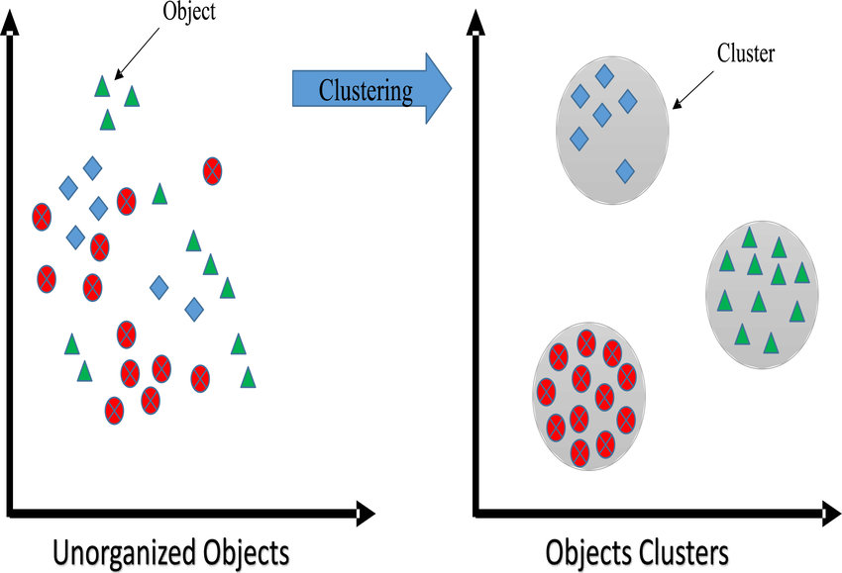
CLUSTERING-CONCEPT
What is clustering?
Suppose we have N number of Unlabeled Multivariate Datasets of various Animals like Dogs, Cats, birds etc. The technique to segregate Datasets into various groups, on basis of having similar features and characteristics, is being called Clustering. Clustering is being used in Unsupervised Learning Algorithm in Machine Learning as it can be segregated multivariate data into various groups, without any supervisor, on basis of common pattern hidden inside the datasets. Here, the objective is to segment the data into similar groups instead of prediction. We can cluster data into ‘similar groups’ and then build a predictive model for each group.

Slide 4
CLUSTERING-CONCEPT
Types of Clustering Methods:
Hierarchical Clustering-Each observation is considered as an individual cluster. Distance from each observation to all others is calculated and the nearest observations are clubbed to form clusters. The decision of merging two clusters is taken on the basis of closeness of these clusters. There are multiple metrics for deciding the closeness of two clusters :
Euclidean distance: ||a-b||2 = √(Σ(ai-bi))
Squared Euclidean distance: ||a-b||22 = Σ((ai-bi)2)
Manhattan distance: ||a-b||1 = Σ|ai-bi|
Maximum distance:||a-b||INFINITY = maxi|ai-bi|
Mahala Nobis distance: √((a-b)T S-1 (-b)) {where, s : covariance matrix}
Intensive distance calculations required thus making it difficult to implement.
K-Means Clustering-K distinct observations are randomly selected at the highest distance from each other. Each observation is considered one by one and clubbed to the nearest cluster. If two clusters come significantly close to each other they are merged to each other to form a new cluster.
Hierarchical Clustering is not suitable for large datasets as the multitude of calculations involved would be impossibly huge. Thus K-means clustering is the most used method of clustering.

Slide 5
CLUSTERING - METHODOLOGY
Clustering follows the methodology of Variable Standardization.
Different Methods Of Variable Standardization:
0-1 scaling: each variable in the data set is recalculated as (V - min V)/(max V - min V), where V represents the value of the variable in the original data set. This method allows variables to have differing means and standard deviations but equal ranges. In this case, there is at least one observed value at the 0 and 1 endpoints.
Dividing each value by the range: recalculates each variable as V /(max V - min V). In this case, the means, variances, and ranges of the variables are still different, but at least the ranges are likely to be more similar.
Z-score scaling: variables recalculated as (V - mean of V)/s, where "s" is the standard deviation. As a result, all variables in the data set have equal means (0) and standard deviations (1) but different ranges.
Dividing each value by the standard deviation. This method produces a set of transformed variables with variances of 1, but different means and ranges.

Slide 6

Why do we need ‘Standardization’?
It is important to standardize variables before running Cluster Analysis. It is because cluster analysis techniques depend on the concept of measuring the distance between the different observations we're trying to cluster. If a variable is measured at a higher scale than the other variables, then whatever measure we use will be overly influenced by that variable.
Generally we standardize by making the mean=0 and variance=1 thus deunitizing the variables and bringing them on common platform to analyze.

Slide 7
DATASET
About The Data: The dataset is of airline. It has 3999 rows and 7 columns.
The columns are as follows:
Balance = number of miles eligible for award travel
• QualMiles = number of miles qualifying for TopFlight status
• BonusMiles = number of miles earned from non-flight bonus transactions in the past 12 months
• BonusTrans = number of non-flight bonus transactions in the past 12 months
• FlightMiles = number of flight miles in the past 12 months
• FlightTrans = number of flight transactions in the past 12 months
• DaysSinceEnroll = number of days since enrolled in the frequent flyer program
Task : Market segmentation is a strategy that divides a broad target market of customers into smaller, more similar
groups, and then designs a marketing strategy specifically for each group. Clustering is a common technique for
market segmentation since it automatically finds similar groups given a data set.
In this problem, we'll see how clustering can be used to find similar groups of customers who belong to an airline's
frequent flyer program. The airline is trying to learn more about its customers so that it can target differentcustomer segments with different types of mileage offers.
I will perform K-means and Hierarchical clustering on this dataset.

Slide 8
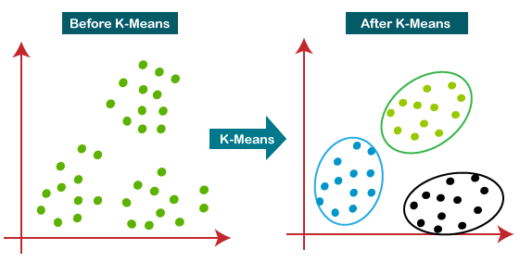
K-MEANS CLUSTERING-CONCEPT
K-Means clustering is one of the most widely used algorithms. It partitions the data points into k clusters based upon the distance metric used for the clustering. The value of ‘k’ is to be defined by the user. The distance is calculated between the data points and the centroids of the clusters.
The data point which is closest to the centroid of the cluster gets assigned to that cluster. After an iteration, it computes the centroids of those clusters again and the process continues until a pre-defined number of iterations are completed or when the centroids of the clusters do not change after an iteration.
It is a very computationally expensive algorithm as it computes the distance of every data point with the centroids of all the clusters at each iteration.

Slide 9
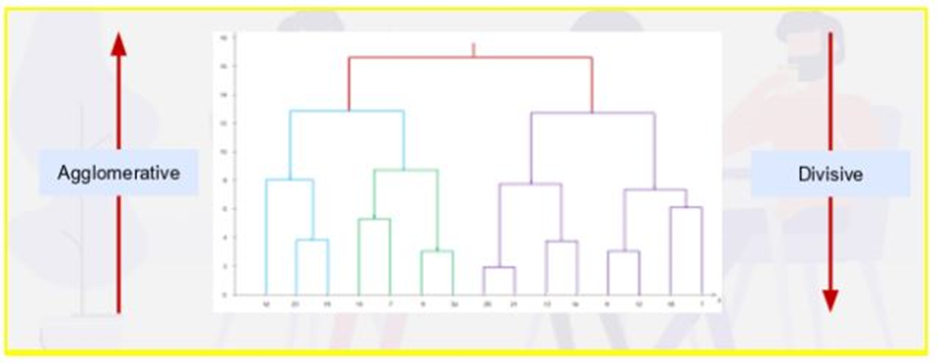
HIERARCHICAL CLUSTERING-CONCEPT
A Hierarchical clustering method works via grouping data into a tree of clusters. Hierarchical clustering begins by treating every data points as a separate cluster. Then, it repeatedly executes the subsequent steps:
Identify the 2 clusters which can be closest together, and
Merge the 2 maximum comparable clusters. We need to continue these steps until all the clusters are merged together.
In Hierarchical Clustering, the aim is to produce a hierarchical series of nested clusters. A diagram called Dendrogram (A Dendrogram is a tree-like diagram that statistics the sequences of merges or splits) graphically represents this hierarchy and is an inverted tree that describes the order in which factors are merged (bottom-up view) or cluster are break up (top-down view). Hierarchical clustering is divided into:
Agglomerative
Divisive
Divisive Clustering-Divisive clustering is known as the top-down approach. We take a large cluster and start dividing it into two, three, four, or more clusters.
Agglomerative Clustering-Agglomerative clustering is known as a bottom-up approach. Consider it as bringing things together.

Slide 10
STEPS TO BUILD CLUSTERING MODEL
STEP1 EXPLORATORY DATA ANALYSIS
STEP2 NORMALIZING/ SCALING THE DATA
STEP3 BUILDING THE K-MEANS CLUSTERING MODEL ON NORMALIZED DATA SET
STEP 4 CHOOSING THE OPTIMUM K, CLUSTERS
STEP 5 MERGING THE PREDICTED CLUSTERS WITH ORIGINAL DATA
STEP 6 ANALYZE THE CLUSTERS WITH THE MEANS OF THE VARIABLES

Slide 11
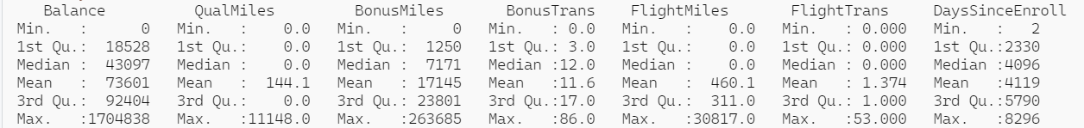
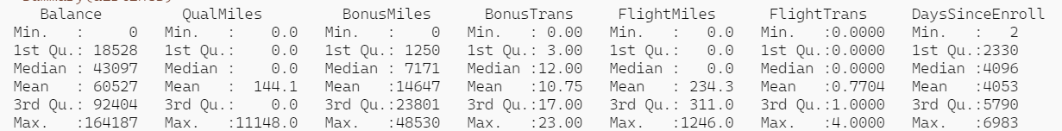
EXPLORATORY DATA ANALYSIS
There are no missing values in the dataset
2. SUMMARY OF ALL THE VARIABLES
As we can see from the summary that all the variables have outliers. So we will treat the outliers for all the variables by using capping method except the “QualMiles” since it contains most outliers, which can be influential while building a model, so we cannot remove them.
SUMMARY OF ALL THE VARIABLES AFTER REMOVING THE OUTLIERS

Slide 12
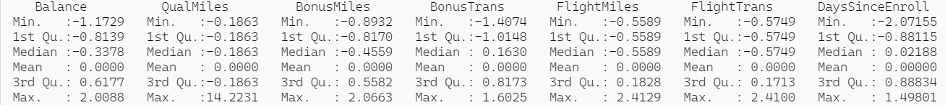
K-MEANS CLUSTERING AND HIERARCHICAL CLUSTERING
NORMALIZING THE DATASET
Normalizing Data is the approach to scale the data into a fixed range usually 0 to 1 so that it reduces the scale of the variables. The summary of the data after normalizing is given below:-
CHOOSING THE OPTIMAL VALUE OF K IN HIERARCHICAL CLUSTERING
To find the optimum value of k in Hierarchical clustering , we need to look at the Dendrogram. A dendrogram is a tree-like structure that explains the relationship between all the data points in the system. However, like a regular family tree, a dendrogram need not branch out at regular intervals from top to bottom as the vertical direction (y-axis) in it represents the distance between clusters in some metric. As you keep going down in a path, you keep breaking the clusters into smaller and smaller units until your granularity level reaches the data sample. In the vice versa situation, when you traverse in up direction, at each level, you are subsuming smaller clusters into larger ones till the point you reach the entire system. As a result, hierarchical clustering is also known as clustering of clustering.

Slide 13
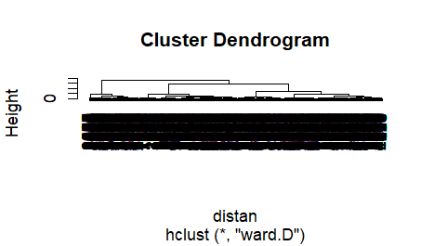

HIERARCHICAL CLUSTERING
After selecting the optimum number of clusters as 5 with the help of dendrogram I have build the Hierarchical clustering model on normalized dataset by assigning points to the clusters. The number of data points under each cluster is given below:

Slide 14
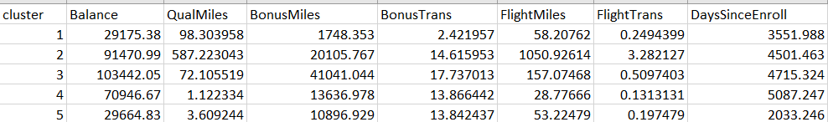
EVALUATION AND ANALYSIS
ANALYZING THE CLUSTERS WITH THE MEANS OF VARIABLES
Means of Variables
Here I have concatenated clusters with the original dataset and then calculated the means of the variables
Since the overall means of all variables from clusters differ from each other we can say that the cluster model performed well with 5 clusters

Slide 15
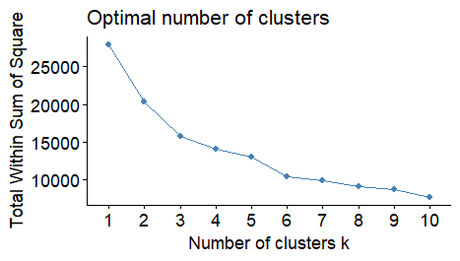
K-MEANS CLUSTERING
CHOOSING THE OPTIMAL VALUE OF K IN K-MEANS
To find the optimum value of k in K-Means , we need to look at the Elbow Method. The Elbow method is a method of interpretation and validation of consistency within-cluster analysis designed to help to find the appropriate number of clusters in a dataset.
The image depict the elbow curve where I have plotted WSS-versus-k . WSS means the sum of distances between the points and the corresponding centroids for each cluster It is clear from the figures that we should take the number of clusters equal to 5, as the slope of the curve is not steep enough after it.

Slide 16

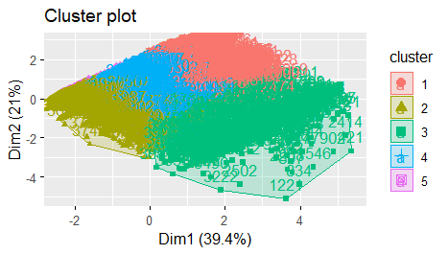
K-MEANS CLUSTERING
After selecting the optimum number of clusters as 5 with the help of Elbow plot I have build the K-meansclustering model on normalized dataset by assigning points to the clusters. The sizes of each cluster is given below:
The scatterplot after clustering:

Slide 17
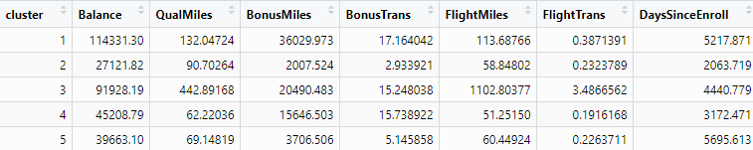
EVALUATION AND ANALYSIS
ANALYZING THE CLUSTERS WITH THE MEANS OF VARIABLES
Means of Variables
Here I have concatenated clusters with the original dataset and then calculated the means
Since the overall means of all variables from clusters differ from each other we can say that the cluster model performed well with 5 clusters

Slide 18
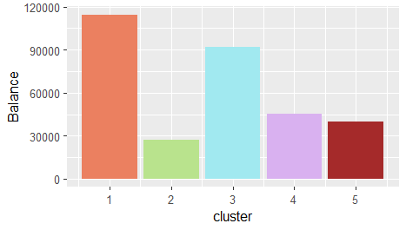
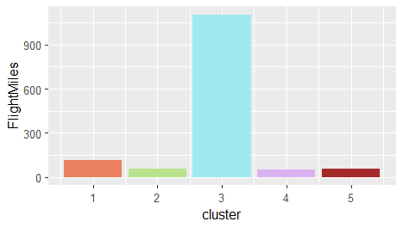
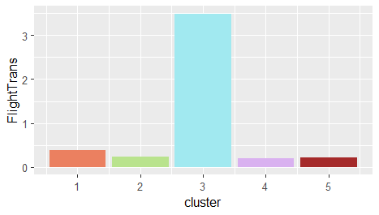
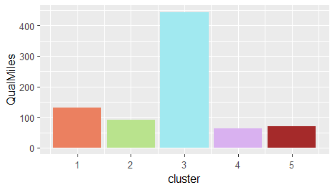
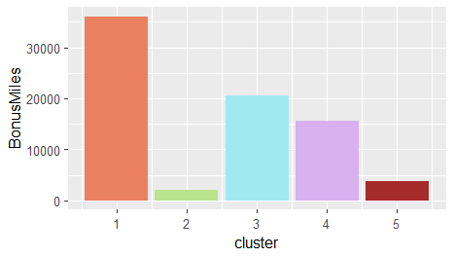
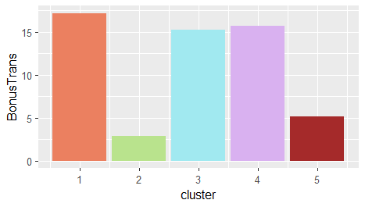
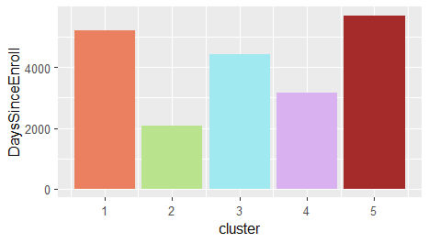
EVALUATION AND ANALYSIS
Here I have plotted the clusters for each of the variables using separate bar plots.

Slide 19
ANALYZING THE RESULTS FROM THE VISUALIZATIONS
Cluster 2 people require highest number of miles to be eligible for award travel
Cluster 4 contains people who require most number of miles to qualify for top flight status .
Cluster 1 people have the highest number of miles earned from non-flight bonus transactions in the past 12 months
Cluster 1 people have the highest number of non-flight bonus transactions in the past 12 months
Cluster 3 people have highest number of flight miles in the past 12 months, whereas we can see that flight miles are quite low for cluster 4 people.
Cluster 3 people have highest number of flight transactions in the past 12 months.
Cluster5, people have enrolled in the flight program for a very long time, longer than the others.
In general, we can see that cluster 3 has the highest flight miles and flight transactions, it’s consists of people who are travelling most so the airline company should focus on this cluster for maximum profit as it seems they are loyal to the company. Now, for Days since enrolled we see that cluster 3 has been enrolled with the company for quite a long time as compared to that of cluster 2 which consists of people who are new or non frequent fliers as their flight transactions and flight miles seems to be lower, so the company should also focus on this set of people in order to generate new set of customers

Slide 20
THANK
YOU

